Slide 1
Introduction to Artificial Intelligence
Slide in this Presentation Contain Hyperlinks. JAWS users should be able to get a list of links by using INSERT+F7
Notes:
If this PowerPoint presentation contains mathematical equations, you may need to check that your computer has the following installed:
1) Math Type Plugin
2) Math Player (free versions available)
3) NVDA Reader (free versions available)

Slide 2
Learning Objectives
Understand the concepts of artificial intelligence
Become familiar with the drivers, capabilities, and benefits of AI
Describe human and machine intelligence
Describe the major AI technologies and some derivatives
Discuss the manner in which AI supports decision making
Notes:
Slide 2 is list of textbook LO numbers and statements

Slide 3
Introduction to Artificial Intelligence
Subfield of computer science
Focused on developing programs that enable computers display “intelligent” behavior
Intelligence displayed by machines as opposed to natural intelligence
Strong relationship between AI and logic
Typical approaches have included simulating the brain, modeling human problem solving, formal logic, large databases of knowledge and imitating animal behavior
Common problem-solving techniques such as:
Search and mathematical optimization
Formal logic
Artificial neural networks
Statistics and probability methods

Slide 4
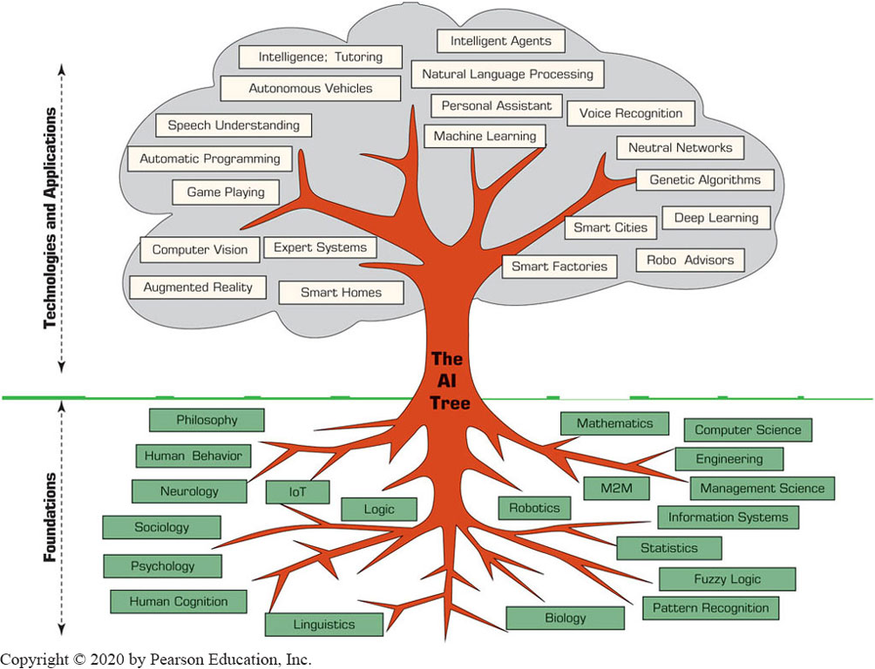
The Functionalities and Applications of AI

Slide 5
Artificial Intelligence – Major Goals
Introduce creativity in business processes and decision making
Reasoning
Knowledge representation
Planning
Learning
Natural language processing
Perceiving – and properly reacting to changes that influence specific business processes and operations

Slide 6
Drivers of Artificial Intelligence
Interest in smart machines and artificial brains
The low cost of AI applications
The pressure on management to increase productivity
The availability of quality data
The increasing functionalities and reduced cost of computers in general
The development of new information technologies, particularly the cloud computing

Slide 7
Benefits of Artificial Intelligence
AI has the ability to complete certain tasks much faster
Consistency of the work
AI machines do not make arbitrary mistakes
AI systems allow for continuous improvement projects
AI can be used for predictive analysis via its capability of pattern recognition
AI can manage delays and blockages in business processes
AI machines do not stop to rest or sleep

Slide 8
Some Limitations of Artificial Intelligence
Lack human touch and feel
Lack attention to non-task surroundings
Can lead people to rely on AI machines too much
Can be programmed to create destruction
Can cause many people to lose their jobs
Can start to think by themselves, causing significant damage
Hypothetically … no evidence of that!
These limitations are diminishing over time

Slide 9
What AI Can and Cannot Do
Three flavors of AI decisions
Assisted intelligence
Autonomous intelligence
Augmented intelligence
Artificial brain
A people made machine “as intelligent, creative, and self-aware as humans”
To date, no one has created such a machine

Slide 10
Human and Computer Intelligence
Types of intelligence:
Linguistic and verbal
Logical
Spatial
Body/movement
Musical
Interpersonal
Intrapersonal
Naturalist
Intelligence is not a simple concept!

Slide 11
Human and Computer Intelligence
Content of intelligence
Reasoning
Learning
Logic
Problem-solving
Perception
Linguistic ability

Slide 12
Human and Computer Intelligence
Capabilities of intelligence
Learning or understanding from experience
Making sense out of ambiguous, incomplete, or even contradictory messages and information
Responding quickly and successfully to a new situation (i.e., using the most correct responses)
Understanding and inferring in a rational way, solving problems, and directing conduct effectively
Applying knowledge to manipulate environment
Recognizing and judging the relative importance of different elements in a situation

Slide 13
Human and Computer Intelligence
Comparing human intelligence with AI
Area | AI | Human
Execution | Very fast | Can be slow
Emotions | Not yet | Can be positive or negative
Computation speed | Very fast | Slow, may have trouble
Imagination | Only what is programmed for | Can expand existing knowledge
Answers to questions | What is in the program | Can be innovative
Flexibility | Rigid | Large, flexible

Slide 14
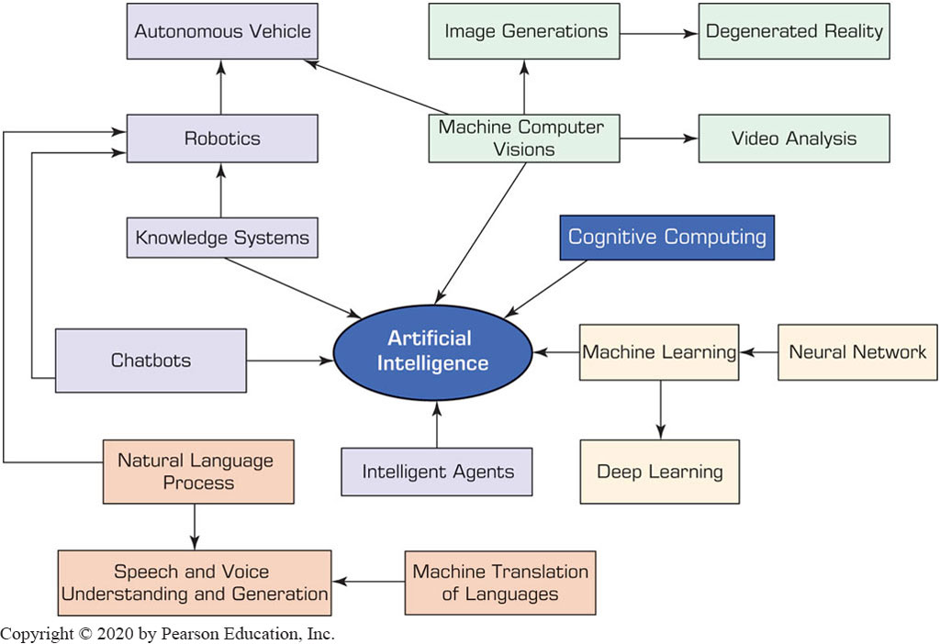
Major AI Technologies

Slide 15
Knowledge and Expert Systems
Knowledge sourced
Cognitive computing
Augmented reality
Knowledge acquisition
Identifying experts
Knowledge representation
Reasoning from knowledge
Knowledge derived from cognitive science
Self learning algorithms
Integration of digital info within user environment in real time
Real + virtual combined
Virtual reality

Slide 16
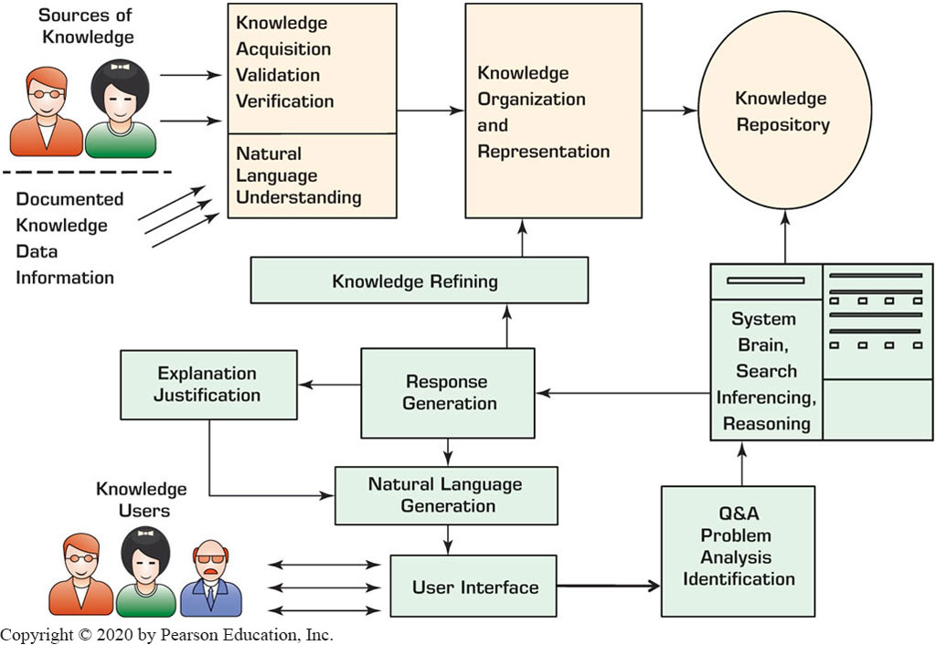
Automated Decision Making Process

Slide 17
Using AI in Decision Making
Issues and factors:
The nature of the decision [routine vs non-routine]
The method of support / technologies used
Expert systems, recommender systems
Deep learning, pattern recognition, biometrics recognition
Cost-benefit and risk analysis
Using business rules
AI algorithms
Speed

